Slide 1



Exploring strategies for coupled 4D-Var data assimilation using an idealised atmosphere-ocean model
Polly Smith, Alison Fowler & Amos Lawless
School of Mathematical and Physical Sciences, University of Reading, UK.

Slide 2
Introduction (1)
Typically, initial conditions for coupled atmosphere-ocean model forecasts are provided by combining analyses from independent (uncoupled) data assimilation systems.
  ignores interactions between systems
  near surface data not fully utilised, e.g. SST, scatterometer winds
Operational centres want to move to coupled data assimilation systems
  strongly coupled assimilation is technically and scientifically challenging
  weakly coupled assimilation systems being developed as a first step

Slide 3
Introduction (2)
We have been using an idealised 1D coupled atmosphere-ocean model framework to assess the expected benefits of moving towards coupled data assimilation in the context of incremental 4D-Var
  avoids many of the issues associated with more complex models
  easier interpretation of results
  guide the design and implementation of coupled methods within full 3D operational scale systems
This talk will focus on
  imbalance at initial time (initialisation shock)
  transfer of information across the air-sea interface

Slide 4
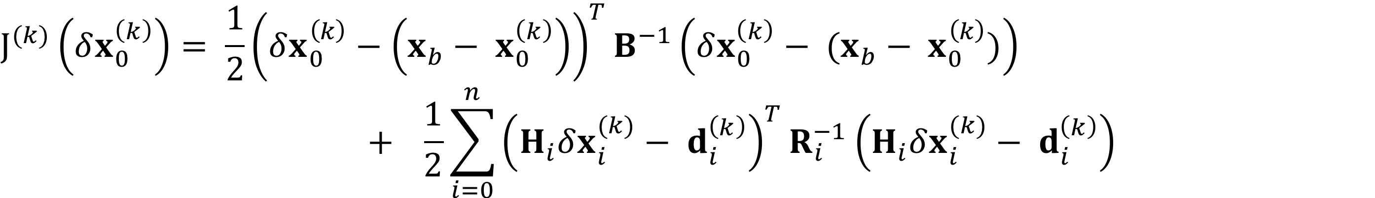
Incremental 4D-Var
Solve iteratively
  set
outer loop: for k = 0, … , Nouter
compute
  inner loop: minimise
  subject to
update

Slide 5
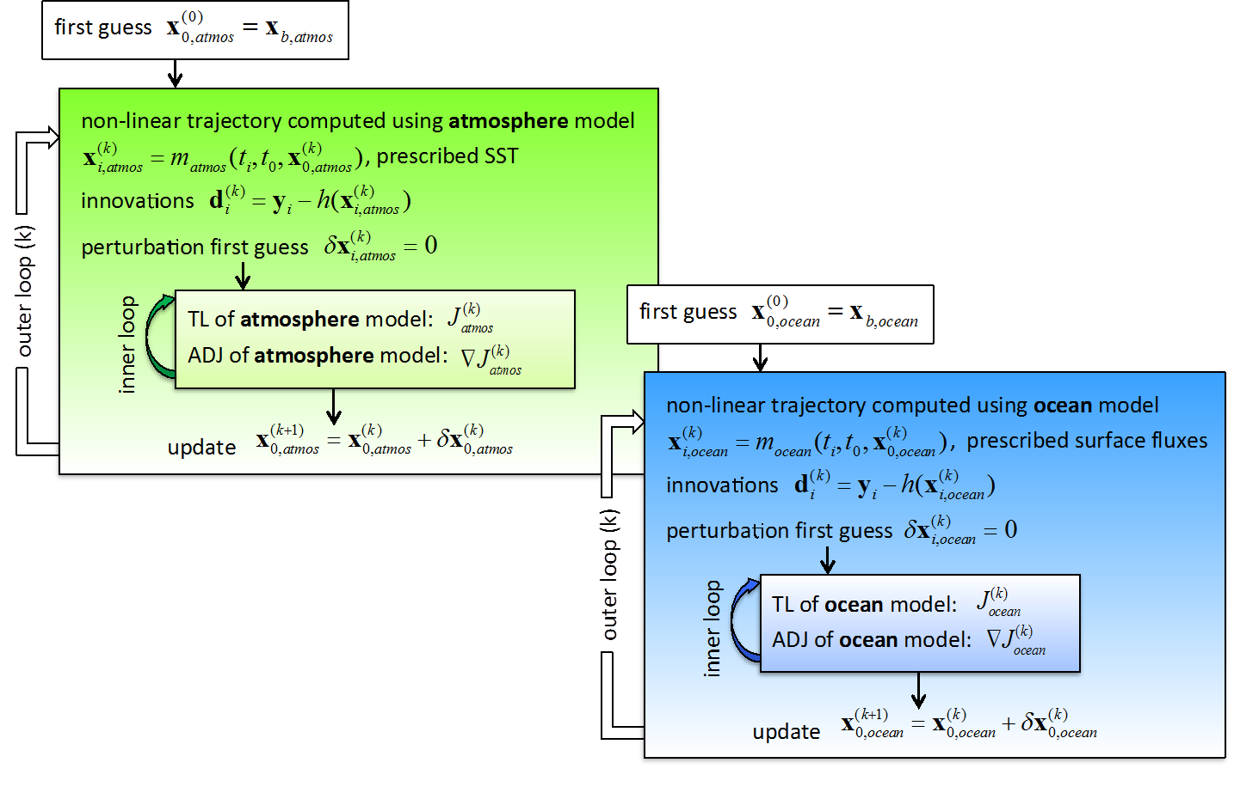
Uncoupled incremental 4D-Var
allows for different assimilation window lengths and schemes in atmosphere and ocean
avoids new technical development
atmosphere obs cannot influence ocean analysis & vice versa
atmosphere and ocean analysis dynamically inconsistent - can lead to imbalance in forecast

Slide 6
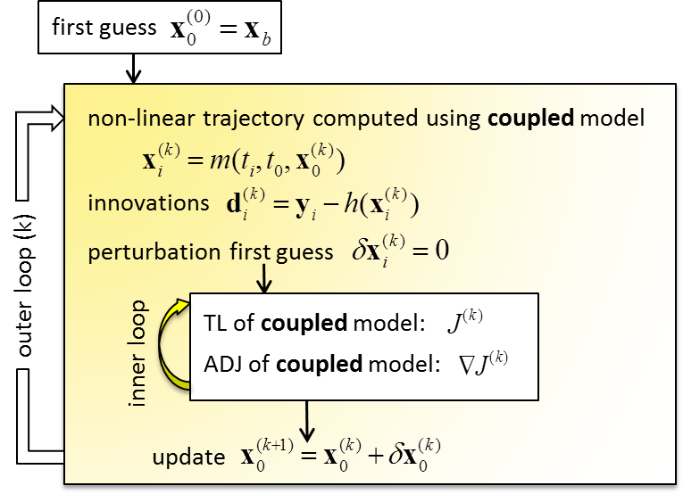
Strongly coupled incremental 4D-Var
coupled model used in both outer and inner loops
allows for cross-covariances between atmosphere and ocean
better use of near surface observations - atmosphere obs can influence ocean analysis & vice versa
requires same window length in atmosphere and ocean
Single minimisation process

Slide 7
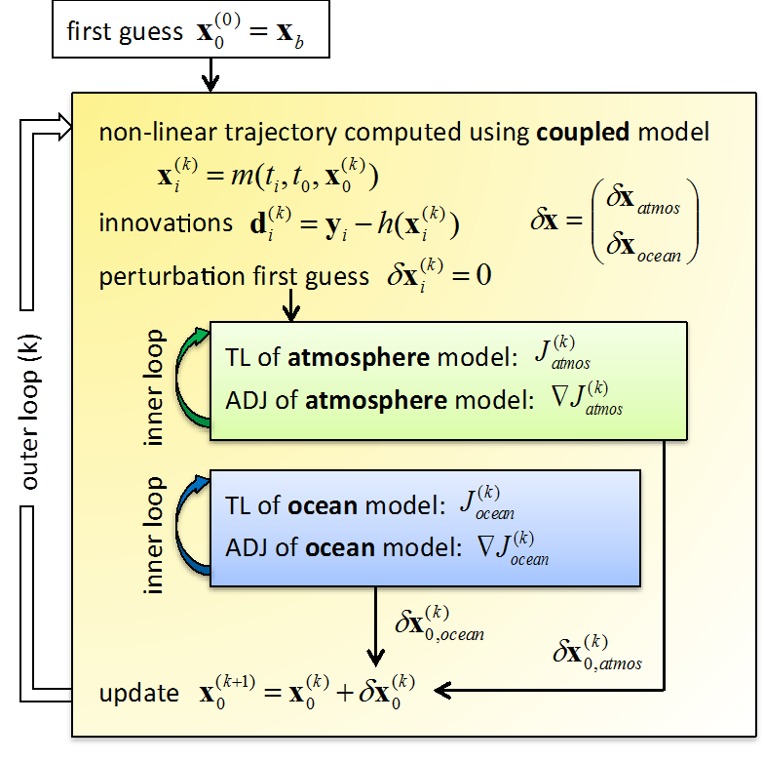
Weakly coupled incremental 4D-Var
coupled model used in outer loop
separate inner loop cost functions
no explicit cross-covariances between atmosphere and ocean
atmosphere (ocean) observations can only influence ocean (atmosphere) analysis if multiple outer loops used
limits amount of new technical development
allows for different assimilation window lengths and schemes in ocean and atmosphere

Slide 8
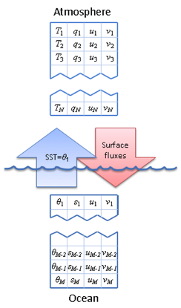
Idealised system
Atmosphere
Simplified version of the ECMWF single column model
  based on early version of the IFS code
  adiabatic component + vertical diffusion
  4 state variables on 60 model levels
  forced by large scale horizontal advection
Ocean
Single column K-Profile Parameterisation (KPP)
mixed-layer model based on the scheme of Large et al¹
  developed by the NCAS climate group at UoR
  4 state variables on 35 model levels
  forced by short and long wave radiation at surface
1. DOI: 10.1029/94RG01872
coupled via SST and surface fluxes of heat, moisture & momentum

Slide 9
Identical twin experiments
comparison of uncoupled, weakly coupled and fully coupled systems
12 hour assimilation window, 3 outer loops
data from June 2013, for point in N Pacific Ocean
'true' initial state is coupled model forecast initialised using ERA Interim and Mercator Ocean data
initial background state is a perturbed coupled model forecast
observations are generated by adding random noise to 'truth'
uncoupled assimilations - SST & surface fluxes from ERA interim
error covariance matrices B and R are diagonal
simple preconditioning of cost function using B^{1/2}

Slide 10
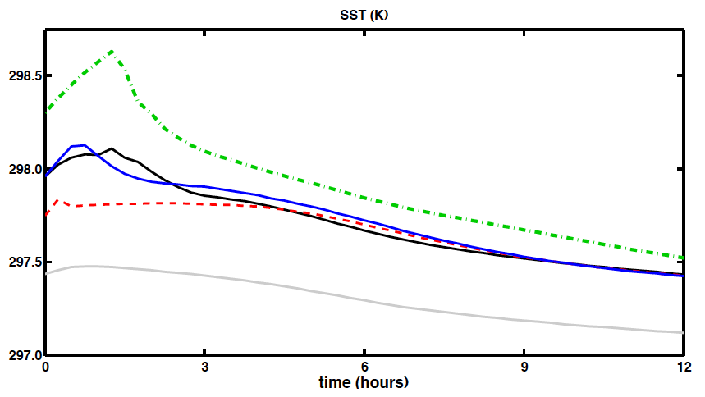
Initialisation shock
truth
background
IC from strongly coupled
IC from weakly coupled
IC from uncoupled
coupled forecast initialised from t₀ analyses
SST (K)

Slide 11
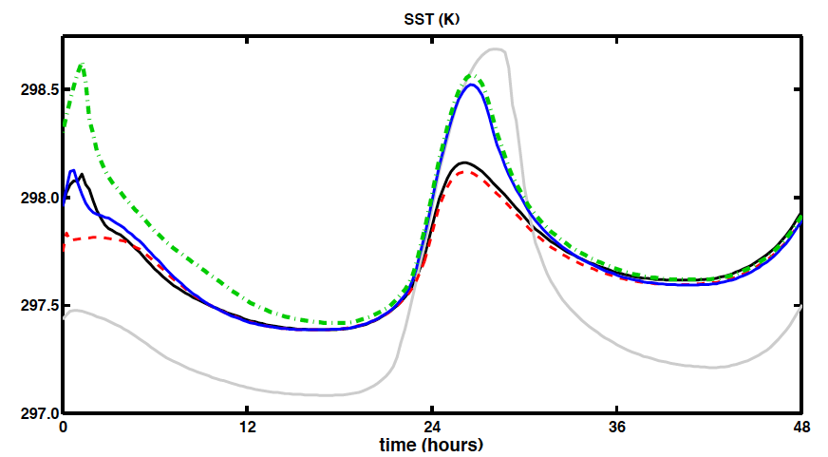
Initialisation shock
truth
background
IC from strongly coupled
IC from weakly coupled
IC from uncoupled
coupled forecast initialised from t₀ analyses
SST (K)

Slide 12
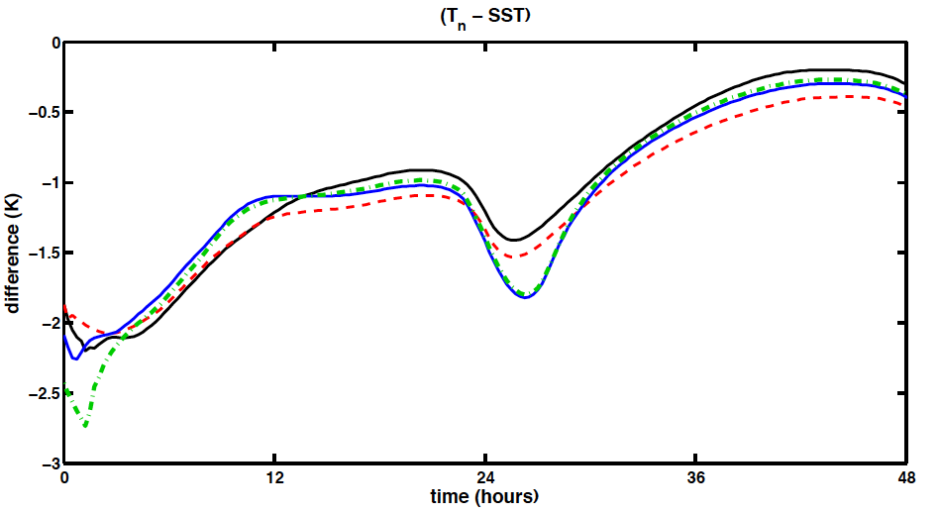
Initialisation shock
truth
IC from strongly coupled
IC from weakly coupled
IC from uncoupled
atmosphere-ocean temperature difference

Slide 13
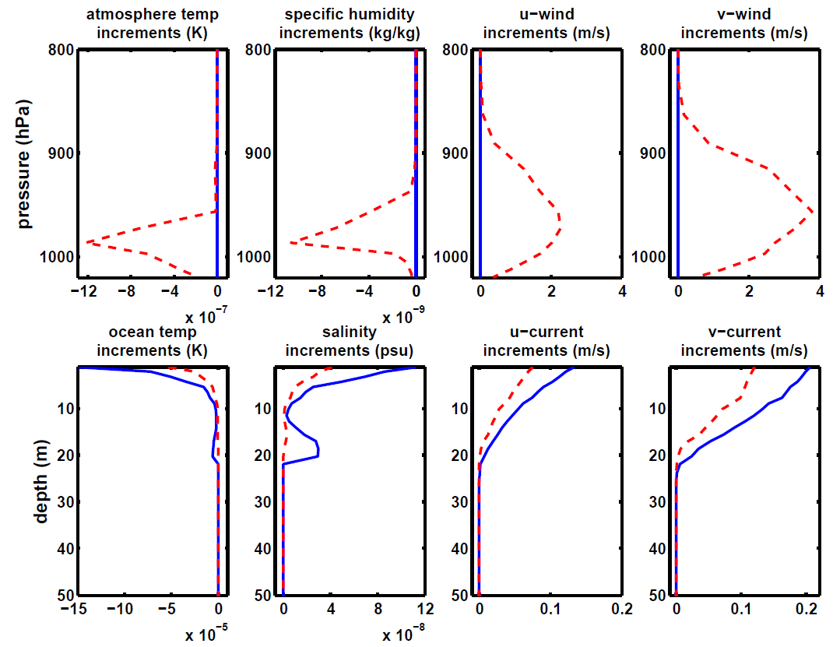
Single observation experiments
Observing ocean surface current at end of assimilation window
strongly coupled
weakly coupled
analysis increments at t = 0

Slide 14
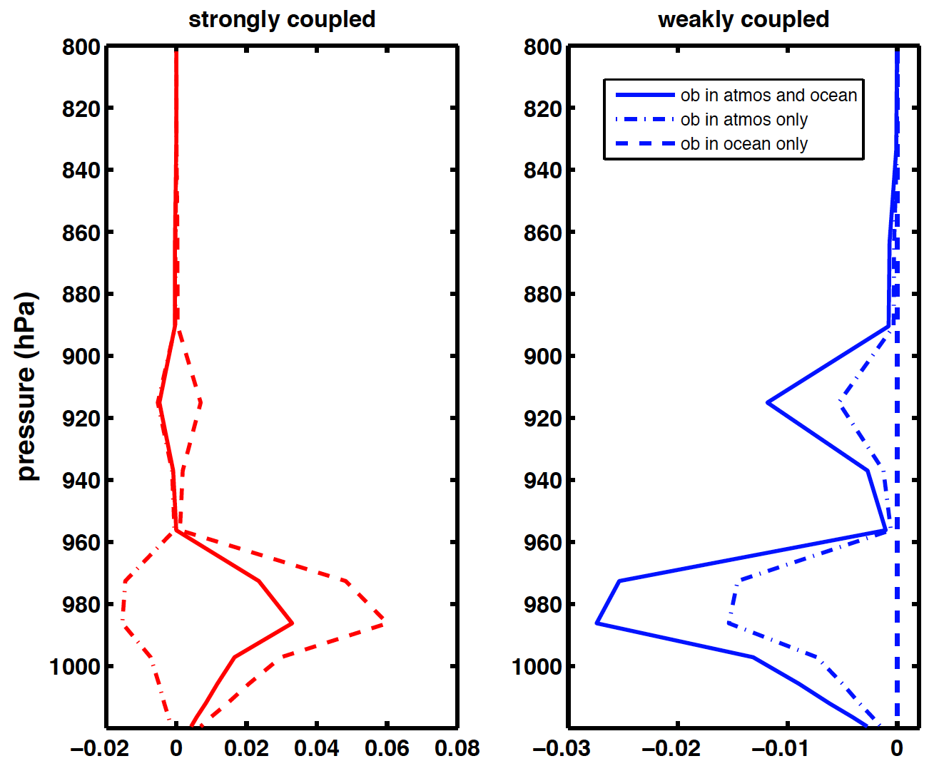
Double observation experiment
atmosphere temperature (K) analysis increments at t=0
atmosphere ob only
ocean ob only
atmosphere & ocean obs

Slide 15
Summary
  demonstrated some of the potential benefits expected from coupled data assimilation systems.
  when compared to uncoupled initialisation, coupled assimilation is able to reduce initialisation shock and its impact on the subsequent forecast - although it may not eliminate it completely.
  weakly coupled system is sensitive to input parameters of the assimilation but still offers benefits over uncoupled system.
  single observation experiments demonstrate how coupled assimilation systems enable improved use of near-surface data by transferring information across the air-sea interface.
  greater transfer of information in weakly-coupled assimilation if both systems are observed.

Slide 16
Future work
  better understanding the nature and structure of the atmosphere-ocean error cross-covariances and how they should be represented in both strongly and weakly coupled systems
  Paper to appear in Tellus A soon, pre-print available at
  www.reading.ac.uk/maths-and-stats/research/maths-preprints.aspx
  or email p.j.smith@reading.ac.uk

Slide 17
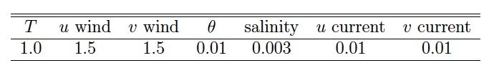
Observation errors

Slide 18
